Slide 1

Anti-Churn MODEL Analytics – Data Science

Slide 2
MotivaTION
Some numbers:
Active base of sellers: 1231 sellers at the beginning of 2018;
Churn: 200 sellers (16,25%) will left the active base the next 3 months;
R$ 1.6 MM/year of potential loss of sells.

Slide 3


WHAT IS churn?
1
2
3
4
5
6
7
8
8
10
11
12
Can we predict 3 consecutive months without sells?

Slide 4

EXPECTED Results

Slide 5
METHOD
Base Composition:
13275 sellers states from 2017 for training the algorithm;
Book of Variables used for training:
Average Ticket;
Receipt;
Sells frequency;
Product types;
Activation of sells over months
Machine Learning Algorithm:
LightGBoost;
Random Search for Tuning

Slide 6
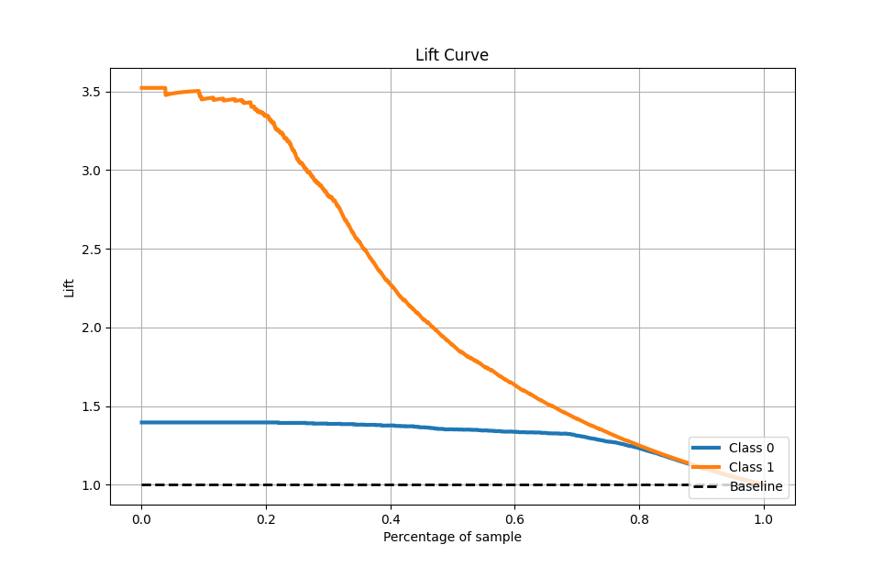
Results
Approaching 32% of active base, we could identify 87% of all sellers who would not sell with Olist for 3 consecutive months.
If retained, these sellers would represent a potential receipt of R$ 1,32 MM/year.

